Slide 1
Analysis of Endangered Species in National Parks
A detailed exploration of conservation status, endangered species, and key insights for future efforts
Michael Edwards 17/03/2025

Slide 2
Species Information Overview
Dataset:
The species_info.csv file contains information about species observed in national parks, including their scientific name, common names, conservation status, and category (e.g., Mammal, Bird, etc.).
Key Columns:
Scientific Name: The formal name of the species.
Common Names: The more widely recognized names of species.
Conservation Status: Categories like Endangered, Vulnerable, and Least Concern.
Category: Type of species (e.g., Mammal, Bird, etc.).

Slide 3
Insights:
Many species have an "Unknown" conservation status, suggesting gaps in available data.
Some species categories (like mammals) are more likely to be in the "Endangered" category, which aligns with conservation concerns.

Slide 4
Significance Analysis – Endangered Species by Category
Chi-Square Test:
The chi-square test was conducted to determine if there is a statistically significant relationship between species categories (e.g., Mammal, Bird) and their conservation status (Endangered, Vulnerable).
Result:
The p-value was 1.89e-05, indicating a significant relationship. This suggests that certain species categories (like mammals) are more likely to be endangered.
Chi-Square Statistic: 53.91636314015659

Slide 5
Conservation Recommendations
Key Insight:
Certain species categories (e.g., mammals) have a higher likelihood of being endangered. This calls for focused conservation efforts on these species.
Recommendation:
Focus more resources on habitat protection, anti-poaching efforts, and monitoring for species at higher risk, like mammals.
Increase funding and awareness for parks with higher biodiversity and higher populations of endangered species.
Collaborate with eco-tourism to raise awareness and fund conservation programs in these parks.

Slide 6
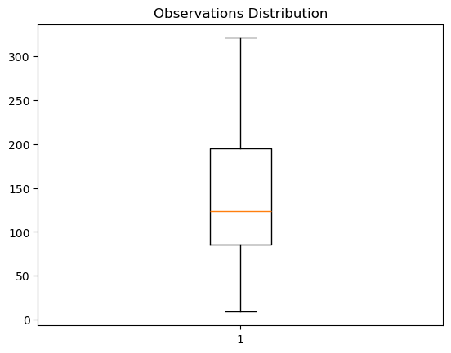
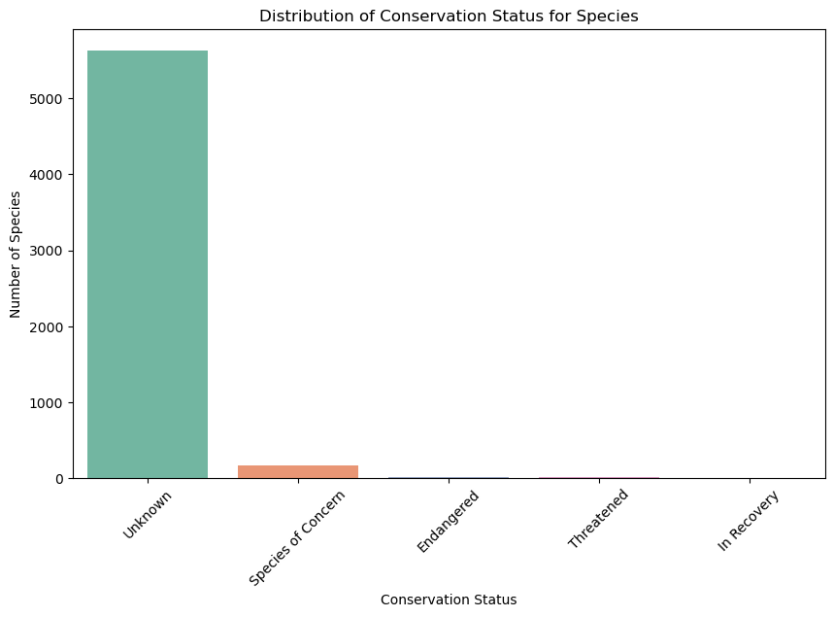
Key Visuals and Findings

Slide 7
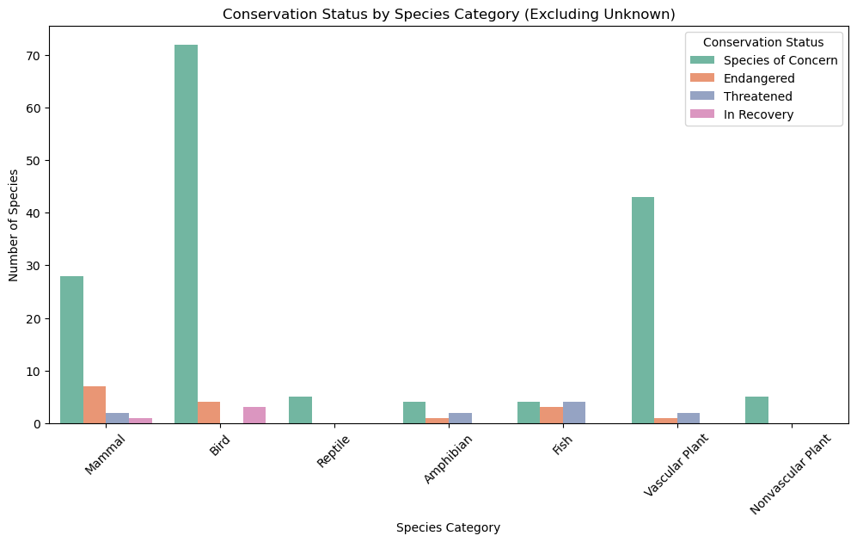
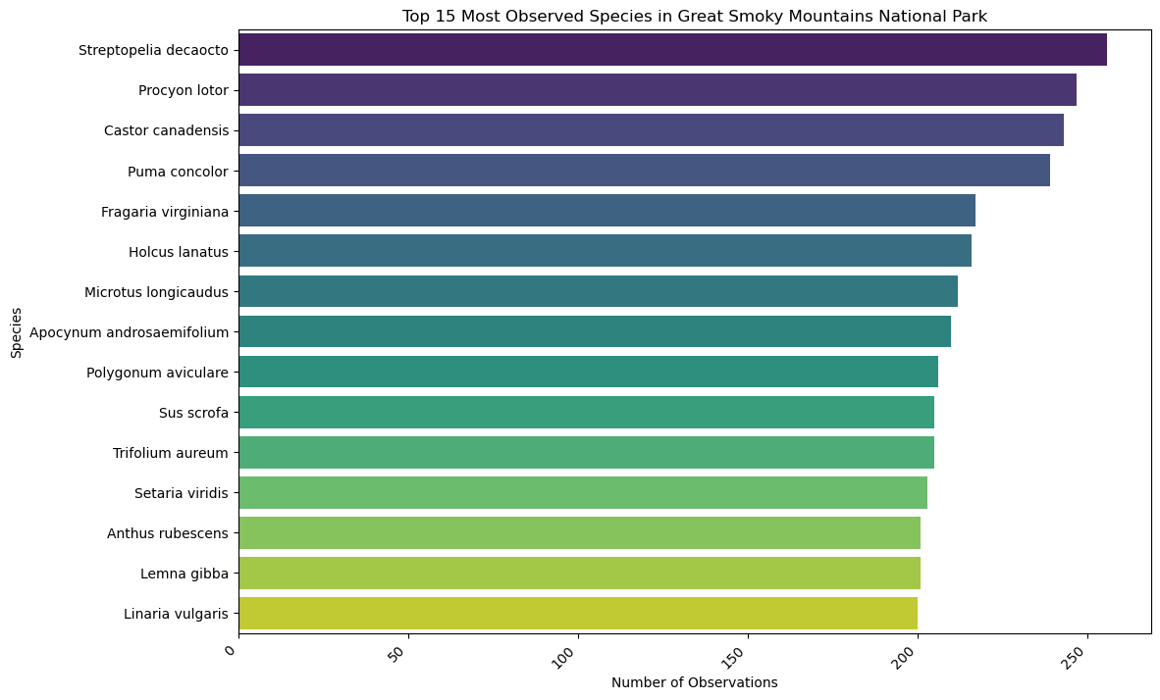

Slide 8
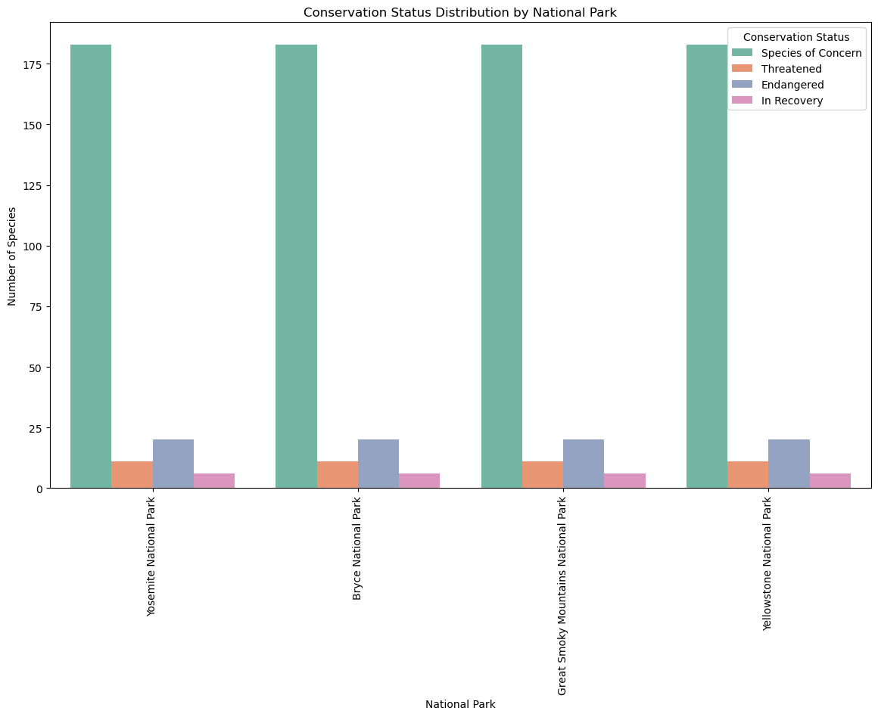

Slide 9
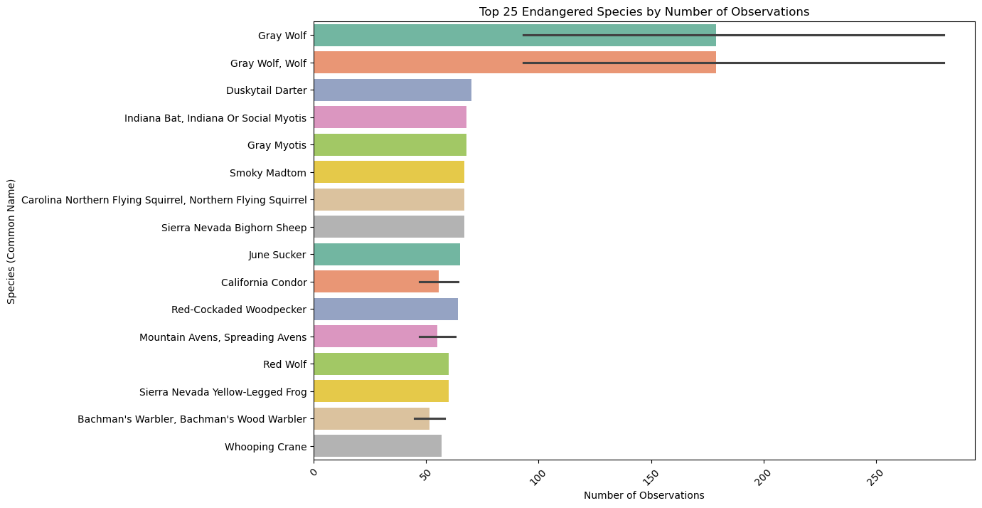

Slide 10
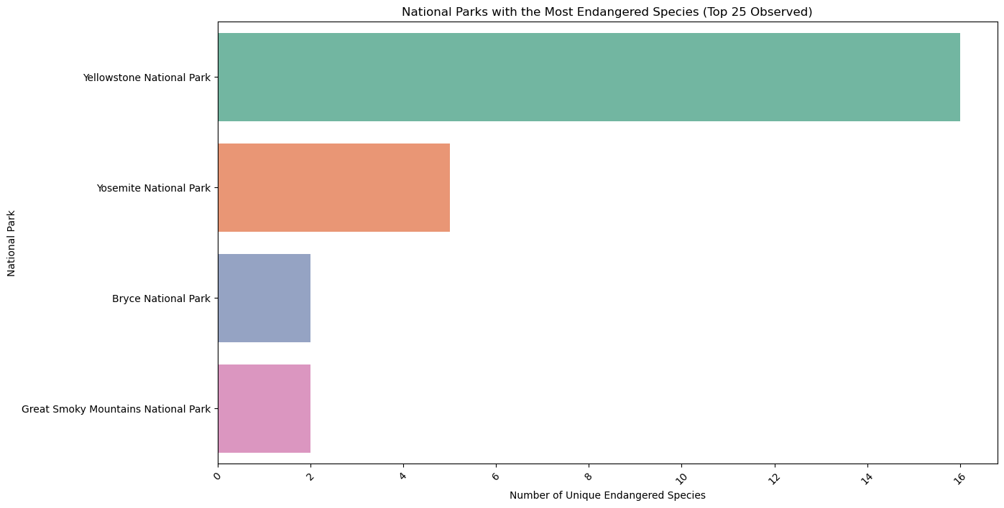

Slide 11
Conclusion
What did we learn throughout the process?
Through the process, we learned valuable insights about the distribution and conservation status of species in various national parks. Specifically, we were able to:
Identify the Top 25 Endangered species based on the number of observations, providing insight into which species are more frequently spotted despite their endangered status.
Visualize the national parks with the highest number of unique Endangered species, helping us understand where these species are most likely to be encountered.
Explore the relationship between species categories, conservation status, and national parks, highlighting the areas that require more focus in terms of conservation and eco-tourism.

Slide 12
Are the results what we expected?
The results largely align with our expectations. We anticipated that:
Certain national parks would have a higher concentration of Endangered species, given the varying habitats and conservation efforts in these parks.
Some species categories (e.g., mammals) would be overrepresented in the Endangered category, as they are more likely to face significant threats from habitat loss, poaching, and climate change.
We also expected that parks with more biodiversity would be home to more Endangered species, making these parks critical for conservation.
While the results aligned with these expectations, the analysis also highlighted areas for improvement, such as the presence of a large number of species with an "Unknown" conservation status. This suggests that more data needs to be collected or made available for certain species to provide a clearer picture of conservation needs.

Slide 13
Key Findings and Takeaways
1. Top 25 Endangered Species:
The top 25 species are the most frequently observed Endangered species in the dataset. These species are relatively easier to spot in the studied parks, but they still face significant conservation risks. Just because these species are observed often does not necessarily mean they are thriving or their conservation status is secure.
2. National Parks with the Most Endangered Species:
Some parks were identified as having the highest concentration of unique Endangered species. These parks are crucial for conservation efforts and represent the biodiversity hotspots that should be prioritized for protection.
Key Takeaway: Parks with higher numbers of endangered species should be key targets for conservation programs, as these species are at a greater risk and require protection from further decline.

Slide 14
3. Conservation and Tourism:
National parks with the most Endangered species can attract eco-tourists, who may be drawn to see these species in their natural habitats. Promoting these parks can generate funds for conservation while supporting local economies.
Key Takeaway: Conservation and tourism can go hand in hand—by focusing on the most biodiverse parks with Endangered species, we can drive awareness and funding for species protection.
4. Focus on Species-Specific Conservation:
Some species categories (like mammals) are more likely to be endangered, and they need specific, targeted conservation efforts. This could involve habitat restoration, anti-poaching efforts, and increased monitoring.
Key Takeaway: A species-specific approach is crucial to ensuring that certain groups of animals receive the support they need to thrive and avoid extinction.

Slide 15
Final Thoughts
The insights gained through this process highlight the importance of understanding both species distribution and conservation status to make informed decisions about conservation priorities. By focusing efforts on the most endangered species and the parks where they are most frequently observed, we can help ensure that these animals have the best chance of survival

